Slide 1
Computer Program

Slide 2
Algorithm
The step-by-step procedure that allows a computer to solve a problem is called as algorithm.
It also specifies the sequence in which these steps are executed for solving the problem.
An algorithm is used to provide a solution to a particular problem in form of well-defined steps. Whenever you use a computer to solve a particular problem, the steps which lead to the solution should be properly communicated to the computer. While executing an algorithm on a computer, several operations such as additions and subtractions are combined to perform more complex mathematical operations.

Slide 3
Example
Write an algorithm to add two numbers entered by the user.
Step 1: START
Step 2: INPUT first number into A
Step 3: INPUT second number into B
Step 4: Sum=A+B
Step 5: Print sum
Step 6: END

Slide 4
Pseudocode
It is a simpler version of a programming code in plain English which uses short phrases to write code for a program before it is implemented in a specific programming language.
It is one of the methods which can be used to represent an algorithm for a program. It does not have a specific syntax like any of the programming languages and thus cannot be executed on a computer.

Slide 5
Example
The following pseudocode shows that a student is “Passed” if she obtains average marks greater than or equal to 50 otherwise “Failed”.
If student’s marks is greater than or equal to 50%
Print “Passed”
Else
Print “Failed”

Slide 6
Flowchart
A flowchart is simply a graphical representation of steps.
It shows steps in sequential order and is widely used in presenting the flow of algorithms, workflow or processes.
Typically, a flowchart shows the steps as boxes of various kinds, and their order by connecting them with arrows.

Slide 7
Flowchart Symbols
Different flowchart shapes have different conventional meanings. The meanings of some of the more common shapes are as follows:
Terminator:
The terminator symbol represents the starting or ending point of the system.
START/END

Slide 8
Input/Output Symbol
It represents information entering or leaving the system. An input might be an order from a customer. Output can be a product to be delivered.
INPUT X,Y

Slide 9
Processing Symbol
A box indicates some particular operation.
S=A+B

Slide 10
Decision
A diamond represents a decision or branching point. Lines coming out from the diamond indicates different possible situations, leading to different sub-processes.
False
True

Slide 11
Page Connector Symbol
This symbol would contain a letter inside. It indicates that the flow continues on a matching symbol containing the same letter somewhere else on a different page.

Slide 12
Flow
Lines represent the flow of the sequence and direction of a process.

Slide 13
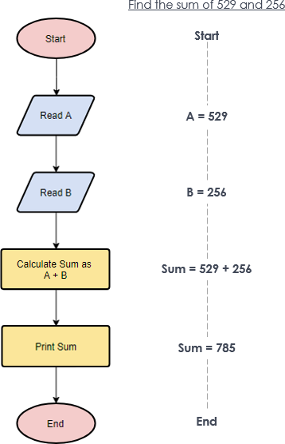
Example

